Slide 1
Everett Youth Hockey MARKETING PLAN
Larissa Long

Slide 2
Issue
Everett Youth Hockey has had consistent numbers of registrations over the last several years without much growth. The pipeline for the whole program is the Beginner Hockey

Slide 3
Objectives
Strategies to encourage parents and kids to register in our beginner programs
Ideas for how to retain kids in the program and grow across all levels

Slide 4
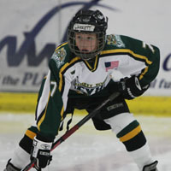
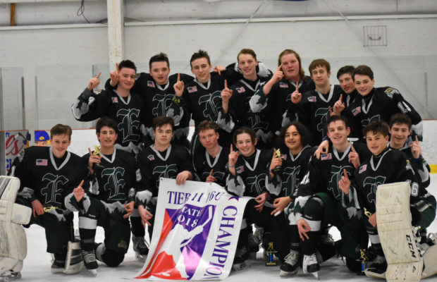
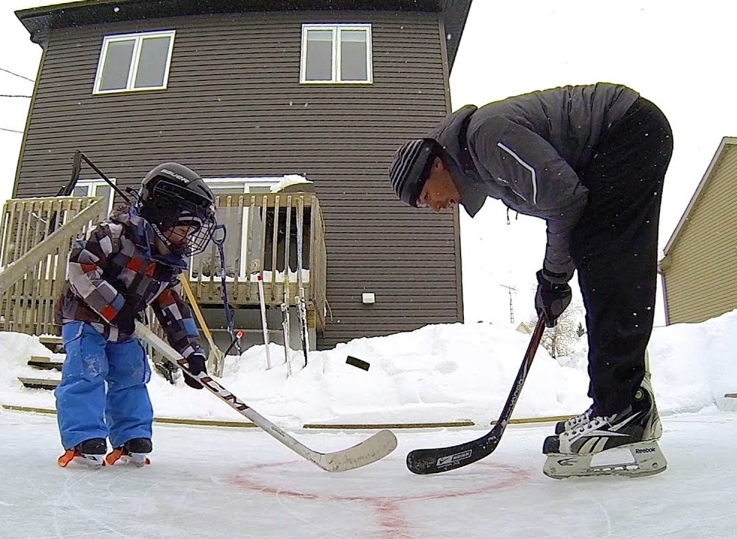
Customer Profile
Children
Teens
Parents
Beginners aged 6 to 13
Ages 14 and Up
Parents with focus on moms
County | Median Household Income | College Educated | Persons per Household | Percent Female
Snohomish | $78,020 | 31.3% | 2.68 | 49.8%
Island | $61,516 | 32.4% | 3.2 | 50.1%

Slide 5
Everett
Customer Profile
All
Married
Non Family
Female
Male
* Based on 2018 census data
Marysville
Lake Stevens
Mukilteo
6%
11%
5%
5%
8%
4%
12%
14%
Persons under 18
22.1%
Persons under 18
25.4%
Persons under 18
28.7%
Persons under 18
22%
44%
37%
31%
54%
23%
58%
30%
59%
Type | Count | Average Size | Owned
All | 42,652 | 2.44 | 44.4
Non Family | 18,929 | 1.3 | 34.6
Married | 15,961 | 3.33 | 61.8
Female | 5,021 | 3.35 | 27.9
Male | 2,741 | 3.45 | 40.2
Type | Count | Average Size | Owned
All | 23,824 | 2.76 | 67.5
Married | 12,812 | 3.42 | 76.6
Non Family | 7,286 | 1.29 | 59.1
Female | 2,497 | 3.4 | 52.7
Male | 1,229 | 3.26 | 53.7
Type | Count | Average Size | Owned
All | 10,582 | 2.93 | 73
Married | 6,161 | 3.39 | 86
Non Family | 2,393 | 1.32 | 64.8
Female | 1,476 | 3.28 | 40.7
Male | 552 | 3.79 | 48.9
Type | Count | Average Size | Owned
All | 8,177 | 2.58 | 68
Married | 4,780 | 3.19 | 79.7
Non Family | 2,481 | 1.25 | 47.7
Female | 615 | 2.97 | 67.6
Male | 301 | 2.85 | 50.5

Slide 6
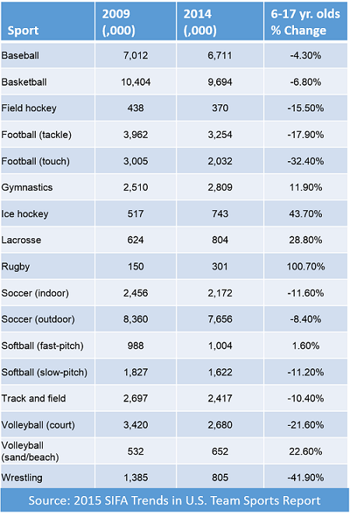
Customer Profile
Youth Hockey continues to grow in most states
In Washington it had grown by 50% ten years ago and continues to grow rapidly
Kids are more likely to play hockey if they play other sports
WA State Rank | 1998-99 players | State pop | Players per capita | 2009-10 players | State pop | Players per capita | % change per capita
14 | 5,447 | 5,756,361 | 0.095 | 7,615 | 6,549,224 | 0.116 | 22.9
* New York Times 2011

Slide 7
Goals & Implementation 1. Strategies to encourage parents and kids to register in our beginner programs
Target schools
Work with the Silvertips
Promote through other sports
Have the Silvertips become more engaged in the community
Have players from the Silvertips visit schools to speak
Get more press for Silvertip players to build up hockey popularity
Hang flyers up at other sports complexes
Build relationships with other youth teams across Everett
Survey players to see what sports they play outside of hockey
Handout flyers at schools
Build relationships with each school for referrals

Slide 8
Goals & Implementation 1. Strategies to encourage parents and kids to register in our beginner programs
Update the website
Social Media
Public Relations
Promote on radio and the Herald
Work with local businesses to help promote and build buzz
Create speaking opportunities for coaches and Silvertip players
Update the website with engaging youth and parent content
Feed social media into the website
Promote to youth through Snapchat, Tik-Tok and Instagram.
Promote to parents through Facebook, Instagram, Twitter, and Pinterest
Create filters and frames to have players promote their teams to their network
Encourage youth to use special hashtags

Slide 9
Goals & Implementation 2. Ideas for how to retain kids in the program and grow across all levels
Silvertip Engagement
Player Spotlight
Surveys
Silvertip mentorship program, working one on one with teen players (14U and up) to advance their hockey career
Regular visits and speaking opportunities for the youth players by Silvertip players
Have a player of the week spotlight
Offer a small prize to the weekly highlight winner
Must have played for at least two years
Player and parent surveys with coaching questions included
Exit interviews with players deciding not to move on
Entry interview asking parents and players what their long-term goals are

Slide 10
Goals & Implementation 2. Ideas for how to retain kids in the program and grow across all levels
Parent Engagement
Player VIPs
Regular Coach Training
Have multiple parent nights throughout the year to keep parents engaged
Use the opportunity to address any concerns and learn what’s working
Chose an annual VIP team to be highlighted by local media
VIP team can be voted on by players and coaches
Use the VIP team to help promote throughout the community through appearances
Offer multiple coaching classes throughout the year for coaches to brush up on new styles and stay current
Use this time to engage with coaches on concerns and learn what’s working

Slide 11
KEY TIMELINE GOAL
08/10/2019
08/26/2019
09/10/2019
10/01/2019
04/01/2019
Create Marketing Plan
Build Out
Implement Marketing
Implement PR Plan
Try Outs
Season Begins
Debrief

Slide 12
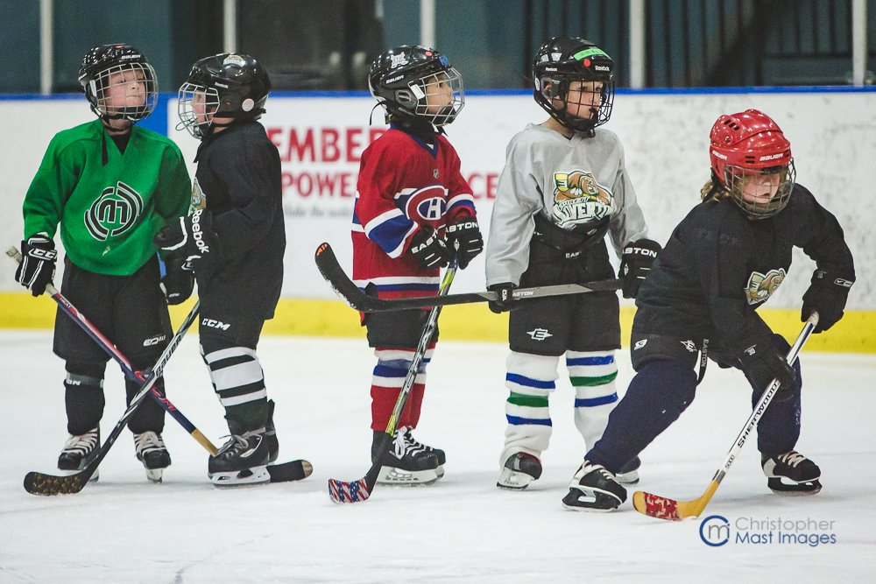
Marketing Evaluation Criteria
Angels of the Wind Arena will evaluate and measure marketing success by the following criteria:
Number of new players
Growth of sastainabilty
Players staying after 14U
Media coverage
Amount of social media engagement
Player data from surveys
Data collected from each marketing partner
Amount of engagement with promotions

Slide 13
THANK YOU!
Larissa Long
253.266.0009
larissalong78@yahoo.com

